Slide 1
PROJECT TITLE : Secure data hiding in images using steganography
CAPSTONE PROJECT
Presented By: Hansika Kancharla
Student Name : Hansika Kancharla .
College Name : National Institute Of Technology Sikkim.
Branch : Computer Science Engineering.

Slide 2
Problem Statement
Develop a steganography tool using Python that can securely embed a secret message within an image file. The tool should utilize a user-provided passcode for basic protection, ensuring that only authorized individuals with the correct passcode can retrieve the hidden message. The implementation must maintain image fidelity, ensuring that the changes caused by embedding the message are imperceptible to the human eye. The solution should be robust, handling various message lengths and image types while providing a user-friendly experience for both embedding and extraction.

Slide 3
Technology used
Main Programming Language : Python
Image Processing and manipulation : OpenCV(cv2)
Image Format (lossless compression) : JPG
Development Environment : Python IDLE
Operating System : Windows 11

Slide 4
Wow factors
Practical Steganography : Demonstrates hiding data in images
Scalable Design : Easy to adapt to advanced techniques.
Real-World Potential : Secure communication with robust encryption(future).
User-Friendly : Simple input/output.
Future Enhancements : Stronger encryption (AES),advanced algorithms.
Current Limitation : Basic password (XOR) is insecure.

Slide 5
End users
Developers :
This tool primarily targets developers and cybersecurity professionals. Developers can integrate its functionality into larger applications . Cybersecurity professionals can use it for incident response, forensics, or secure organizational communication. The open-source nature fosters community contributions and feature expansion.
Potential Users :
Currently a proof-of-concept, this tool aims to serve individuals and organizations needing discreet communication . Potential users include journalists, activists, or businesses protecting sensitive data.
Future development will focus on robust encryption and user-friendly interfaces for broader accessibility.
Balanced :
This tool serves both developers/cybersecurity experts (via API integration) and individuals seeking simple secure data hiding. Future development balances enhanced security with user-friendly design, catering to both specialized and general user needs.
Who are the end users

Slide 6
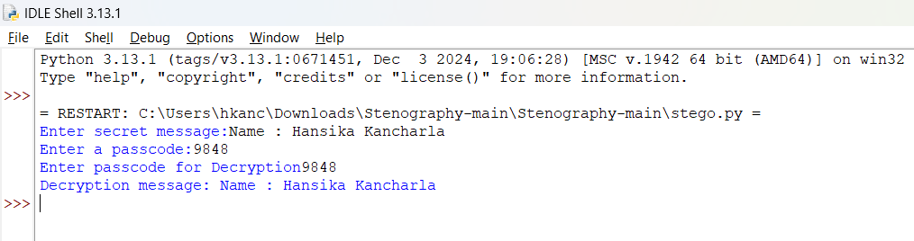
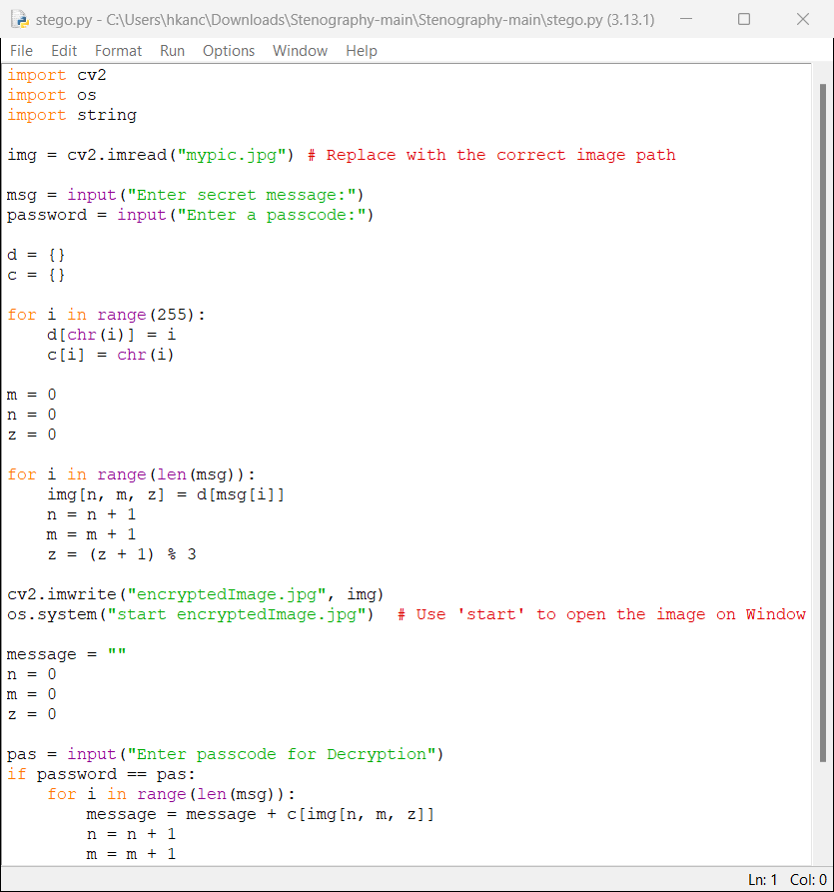
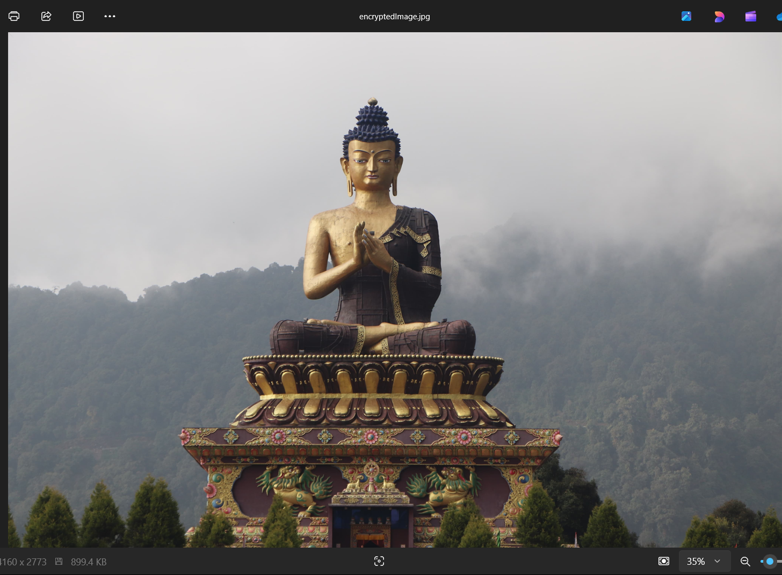
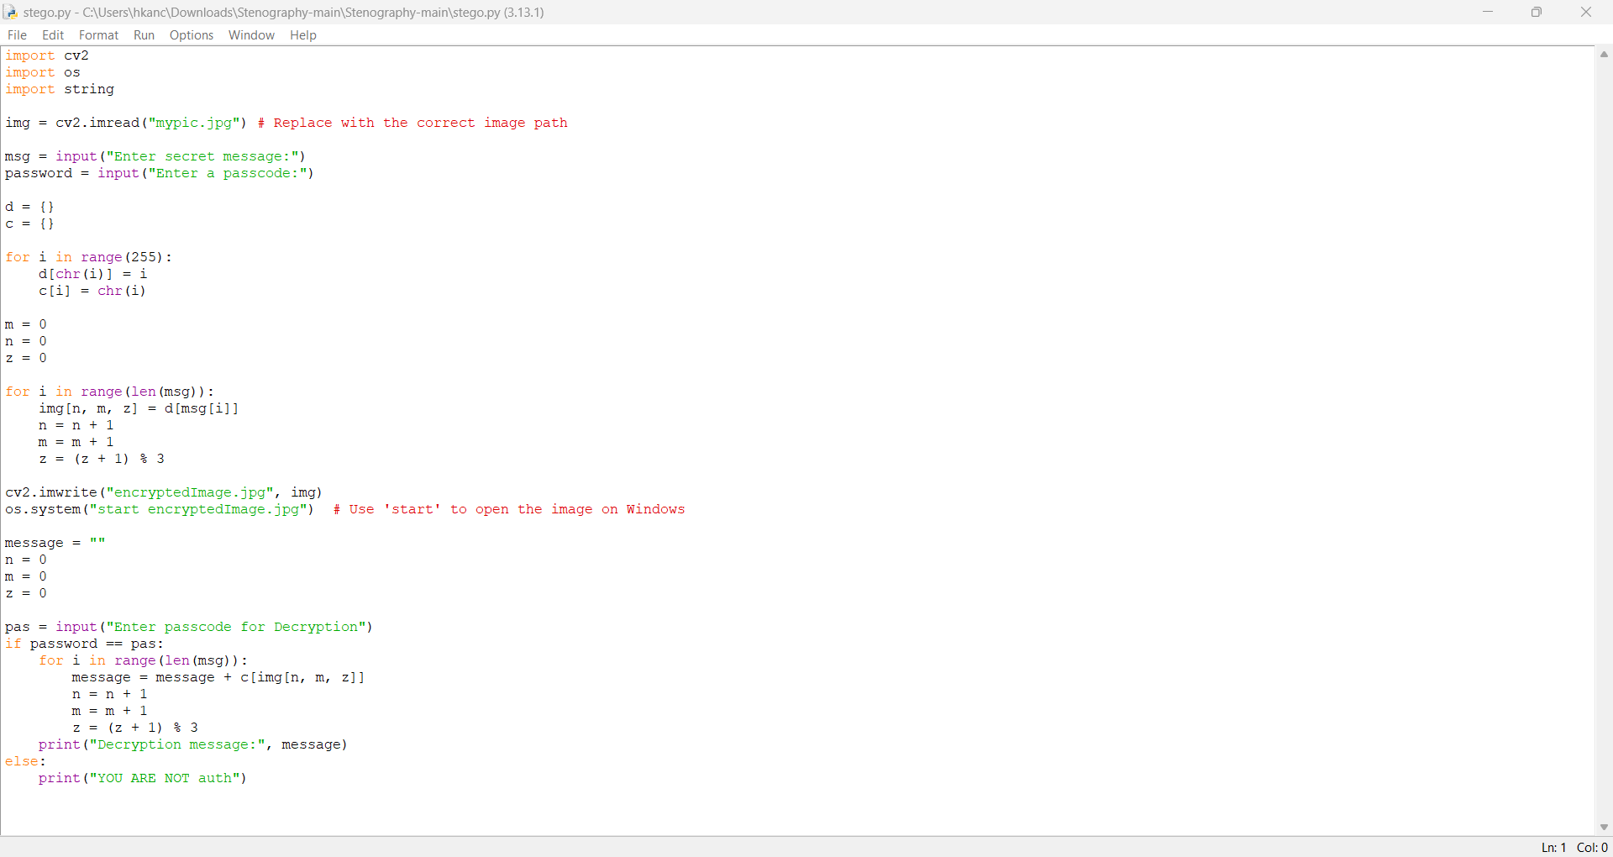
Results

Slide 7
Conclusion
This project Successfully developed a foundational steganography tool capable of embedding text messages within images using the Least Significant bit(LSB) modification technique. While a basic passcode system was implemented for demonstration, future development will prioritize integrating robust encryption algorithms, such as AES, to ensure true security in real-world applications. Furthermore, research into more advanced steganographic methods will be explored to enhance the tool's capacity, imperceptibility, and resilience against steganalysis. This work serves as a valuable proof-of-concept, laying the groundwork for creating a more sophisticated and secure steganography solution capable of protecting sensitive information in an increasingly digital world.

Slide 8
GitHub Link
https://github.com/hansikakancharla/my-cybersecurity-project-aicte.git

Slide 9
Future scope(optional)
Enhance Security: Integrate robust AES encryption and explore steganalysis countermeasures.
Expand Functionality: Support diverse data types (images, audio) and increase embedding capacity.
Improve User Experience: Develop a user-friendly graphical interface.
Ensure Compatibility: Make the tool cross-platform compatible (Windows, macOS, Linux).
API Development: Create an API for easy integration into other applications.

Slide 10
THANK YOU

